Slide 1

MODEL VIEW CONTROLLER (MVC)
GROUP-02
TAREQ RAHMAN ID-141014020
MAHMUD HOSSAIN ID-142014041
NAHID REZA ID-143014013
MRINMOYEE DEY AMIN ID-143014037
AFSANA SHIKDER SAMIA ID-143014047
NADIA RAHMAN ID-143014026
ATIK-UZ-ZAMAN ID-143014054
MD. ASIFUZZAMAN JISHAN ID-143014010

Slide 2
WHAT IS MVC?
It is a software architecture pattern which separates the representation of information from the user's interaction with it.
The model consists of application data, business rules, logic, and functions.
A view can be any output representation of data, such as a chart or a diagram.
The Controller, in modern applications is a module, or an intermediary section of code, that mediates communication (between the Model and View) and unifies validation.

Slide 3
BRIEF HISTORY OF MVC
MVC was one of the first works to describe and implement software constructs in terms of their responsibilities.
Trygve Reenskaug introduced MVC in the 1970s
In the 1980s, Jim Althoff and others implemented a version of MVC .
MVC was expressed as a general concept, in a 1988 article.

Slide 4

FATHER OF MVC
Trygve Mikkjel Heyerdahl Reenskaug (born 1930 | Age 83) is a Norwegian computer scientist and professor emeritus of the University of Oslo.
He formulated the model-view-controller (MVC) pattern for Graphic User Interface (GUI) software design in 1979 while visiting the Xerox Palo Alto Research Center (PARC).

Slide 5




SOME MVC FRAMEWORKS
Django (Python)
Rails(Ruby)
Laravel (PHP)
CodeIgniter (PHP)
ASP.NET MVC

Slide 6
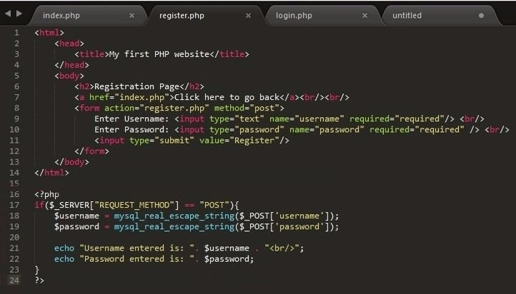


MODEL
CONTROLLER
VIEW

Slide 7

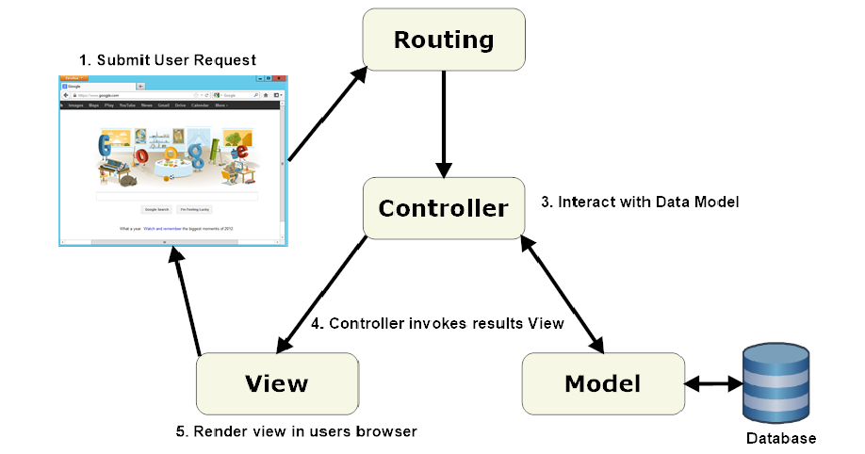
Work flow of MVC
2. DATA ROUTE

Slide 8
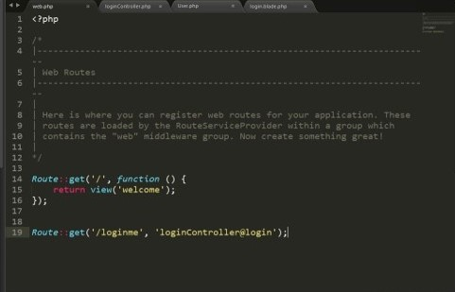
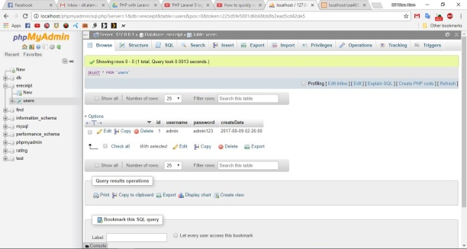
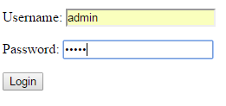
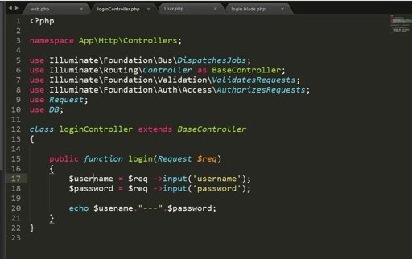
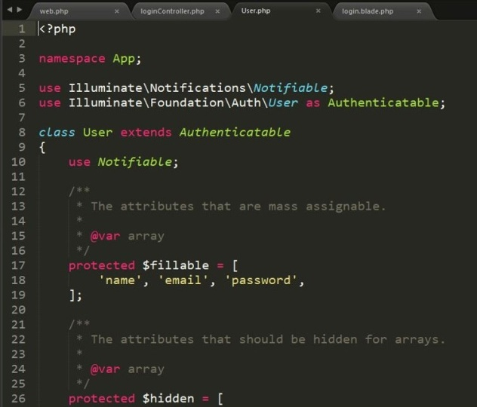
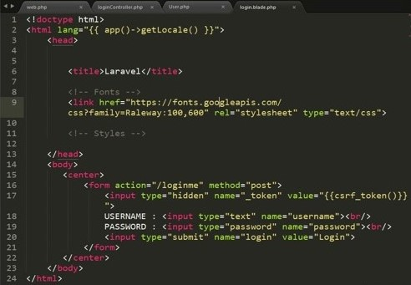
Routing
1
User
Database
Controller
2
5
4
8
Model
View
7
3
6

Slide 9
ADVANTAGES
More Structural
More Flexible
Can maintain code in better ways.
More suitable for future implementations
Reduce Complexity

Slide 10
DISADVANTAGES
The complexity is high to develop the applications using this pattern without learning properly.
Not right suitable for extra-small applications .
The isolated development process by UI authors, business logic authors and controller authors may leads to delay in their respective modules development.

